Slide 1


WELCOME TO

Slide 2


IEEE ORIENTATION

Slide 3


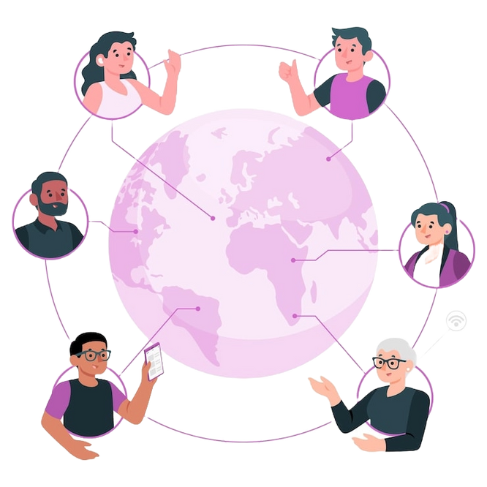


WHAT IS IEEE?
🌍 Global Community
👥 Massive Network
💡 Innovation Hub
🏆 Professional Recognition

Slide 4
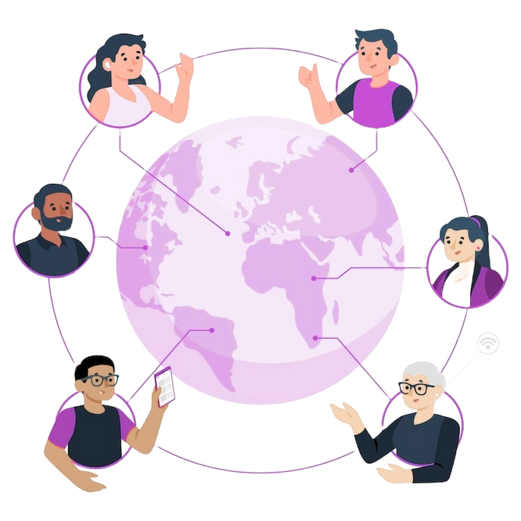
WHAT IS IEEE?
🌍 Global Community
👥 Massive Network
💡 Innovation Hub
🏆 Professional Recognition
IEEE is the world’s largest organization for technology and engineering professionals, connecting innovators worldwide.

Slide 5
WHAT IS IEEE?
👥 Massive Network
🌍 Global Community
💡 Innovation Hub
🏆 Professional Recognition
With 400,000+ members across 160+ countries, it creates opportunities to collaborate, learn, and grow.

Slide 6
WHAT IS IEEE?
💡 Innovation Hub
🌍 Global Community
👥 Massive Network
🏆 Professional Recognition
IEEE drives research and development in cutting-edge fields, shaping the future of technology.

Slide 7
WHAT IS IEEE?
🏆 Professional Recognition
🌍 Global Community
👥 Massive Network
💡 Innovation Hub
Membership boosts your profile and gives you credibility in the global tech community.

Slide 8
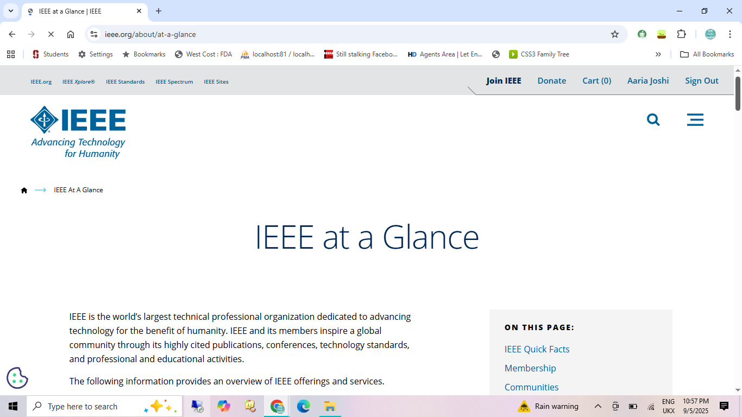
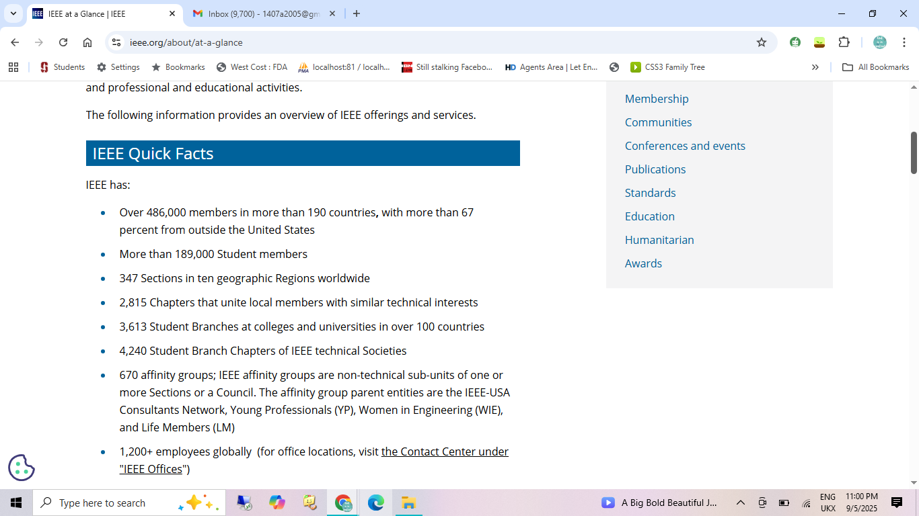
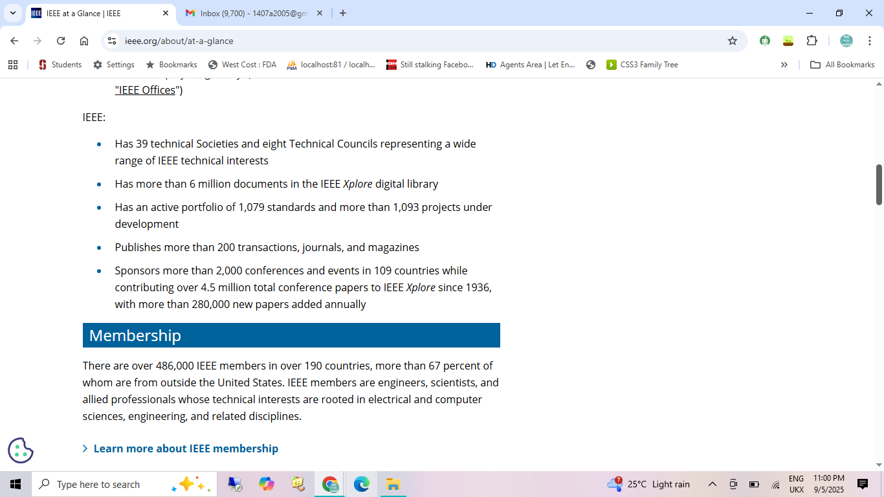
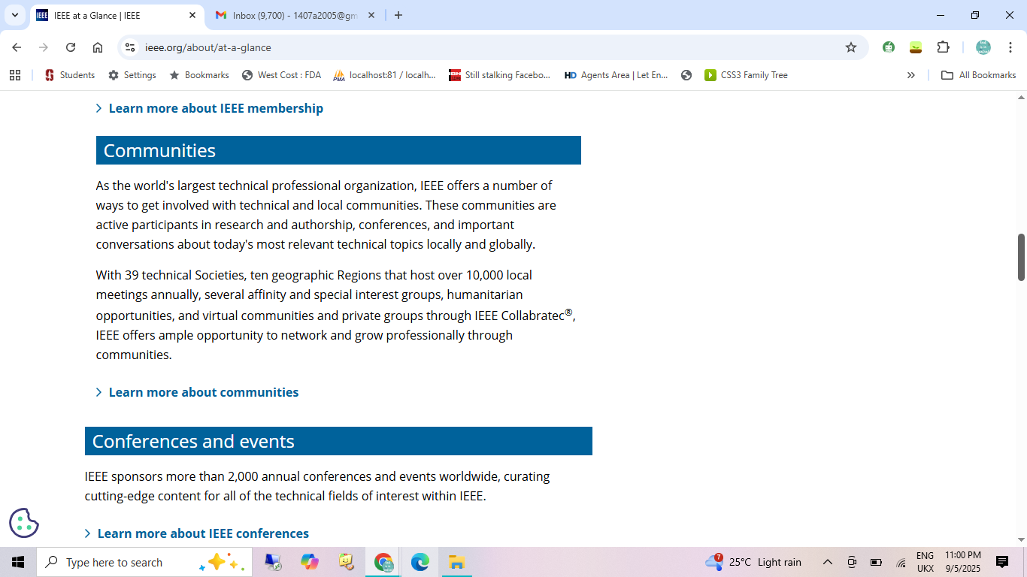
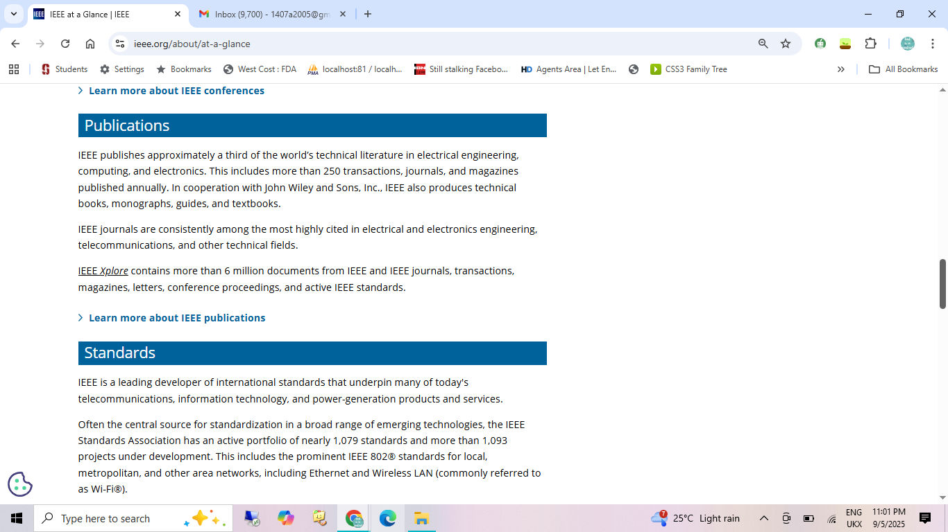
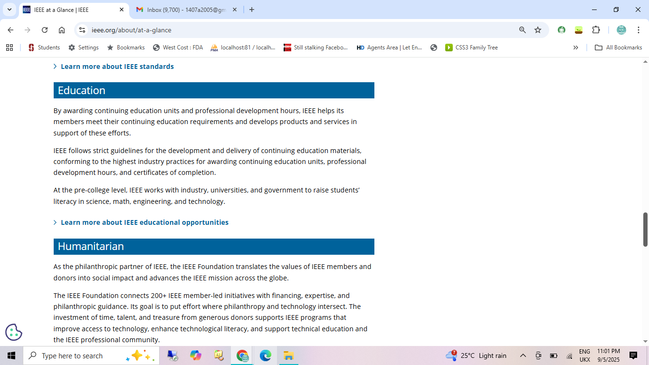
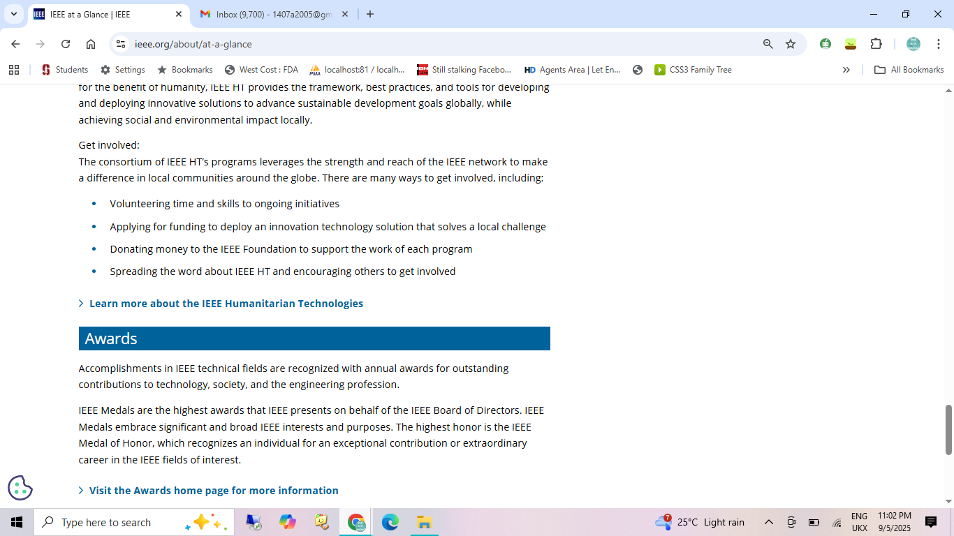
Inside IEEE
A global platform uniting technology leaders, students and professionals.

Slide 9
IEEE Facts
Founded in 1963, IEEE is a powerhouse of innovation with 1,200+ conferences and 200+ journals each year.

Slide 10
Membership Benefits
Empowering students and professionals with resources, networking and career opportunities.

Slide 11
Communities and Events
Be part of vibrant IEEE communities and showcase your ideas through global conferences and workshops.

Slide 12
Publications and Standards
Access world-class journals and global technology standards that shape industries.

Slide 13
Education and Humanitarian
Advancing learning worldwide while driving technology for social good.

Slide 14
Awards
Recognizing excellence and inspiring innovation in science, engineering and technology.

Slide 15




WHY IEEE?
The benefits of an IEEE membership!

Slide 16
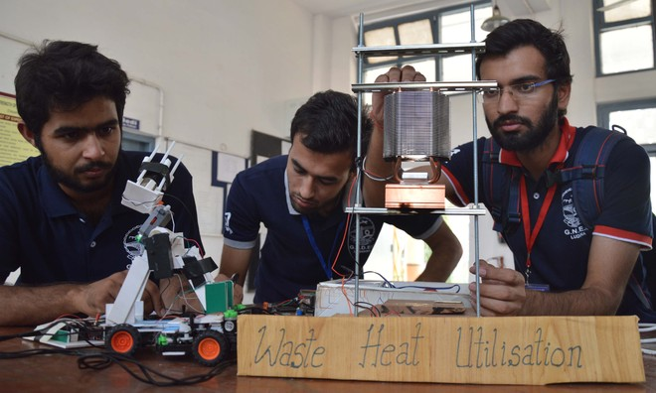
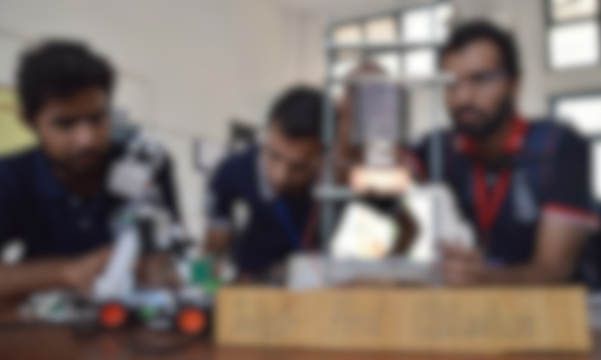

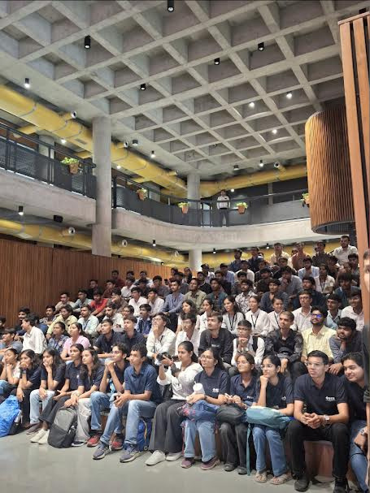
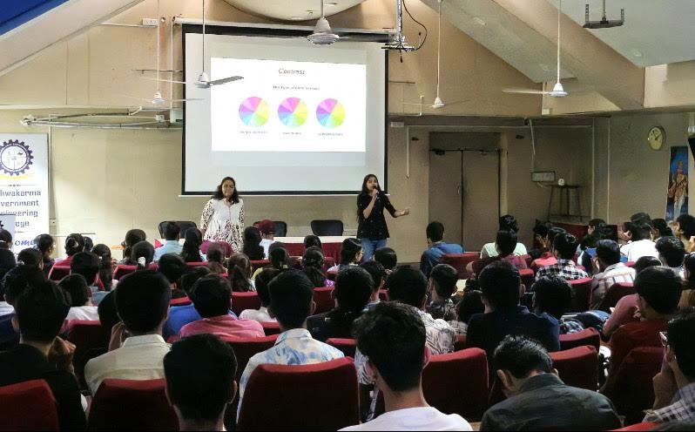
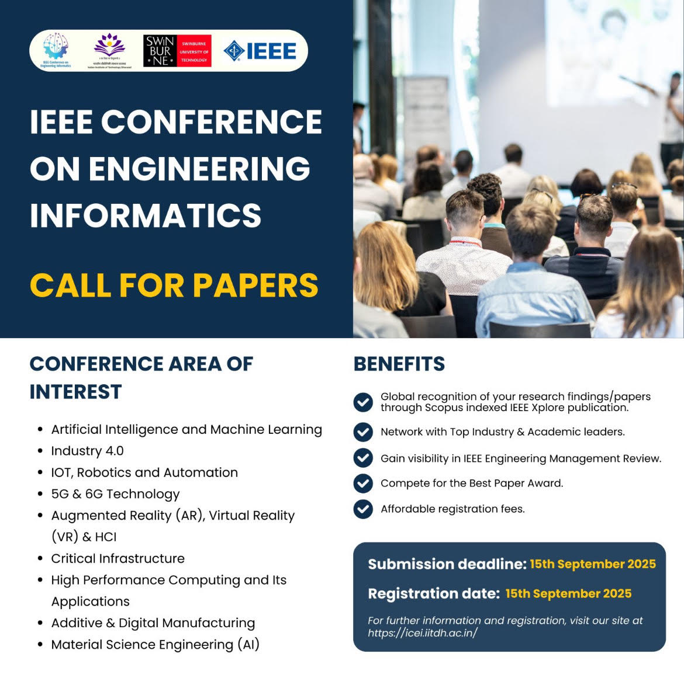
Professional Development
IEEE offers hands-on experiences through workshops, hackathons, design challenges, and technical projects. Members gain exposure to cutting-edge technology, learn practical applications beyond textbooks, and develop skills needed in real-world engineering and research.

Slide 17

Networking
IEEE is a global community with members in 160+ countries. You can connect with professors, industry experts, researchers, and peers through conferences, local chapter meetings, and student branch activities—building friendships, mentorships, and collaborations that last a lifetime.

Slide 18

Knowledge & Resources
With membership, you get access to the IEEE Xplore Digital Library, which hosts over 5 million research papers, journals, conference proceedings, and technical articles. This ensures students and professionals always stay updated with the latest scientific and engineering innovations.

Slide 19
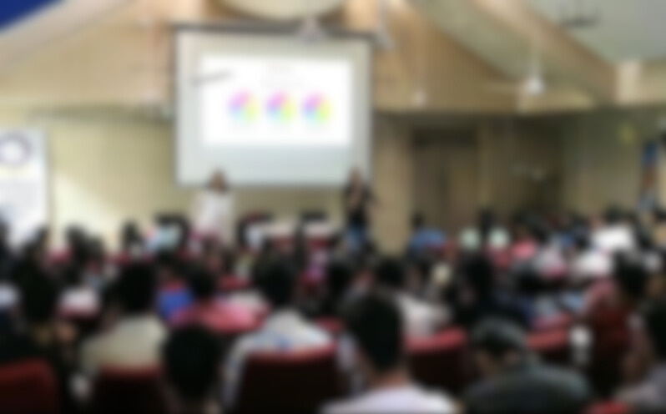
Leadership Skills
By leading student branches, committees, or projects, members develop crucial leadership qualities—teamwork, decision-making, communication, and project management. This experience helps shape you into a confident professional who can guide teams and innovate.

Slide 20

OUR JOURNEY SO FAR..
OUR JOURNEY SO FAR..

Slide 21

MEET OUR COMMITTEES

Slide 22
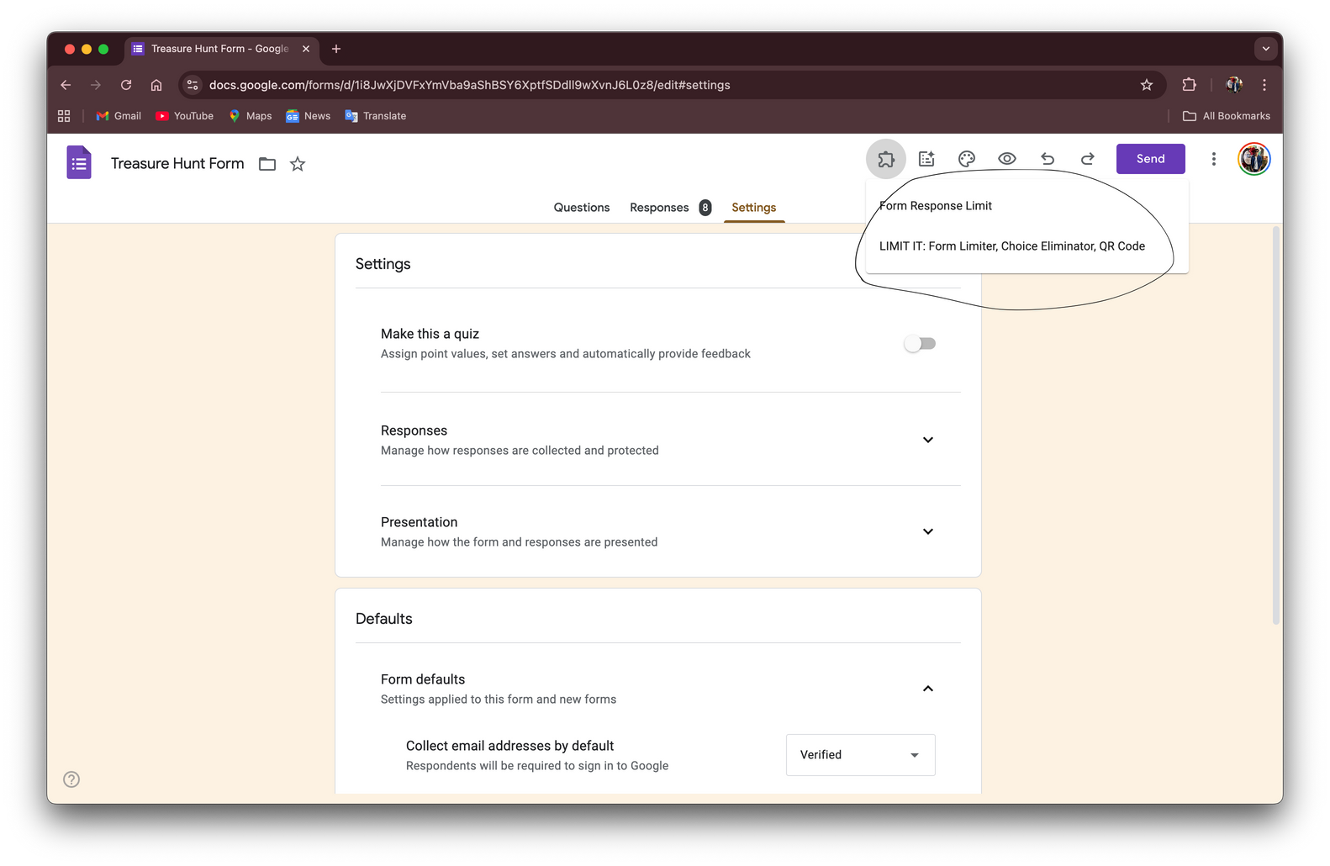

program committee
“WE SCRIPT THE SHOW YOU
REMEMBER.”

Slide 23
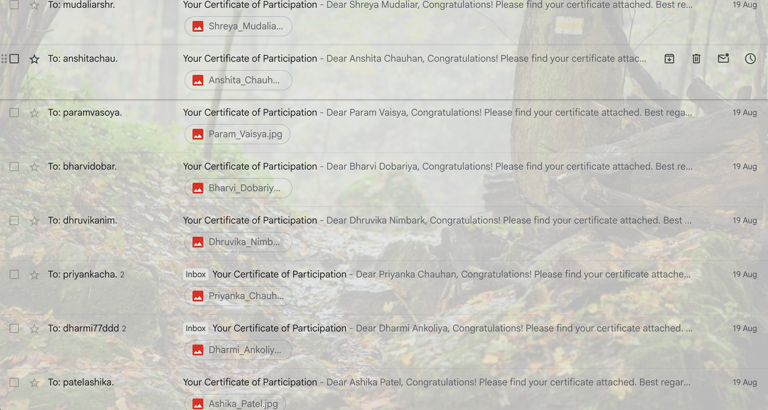
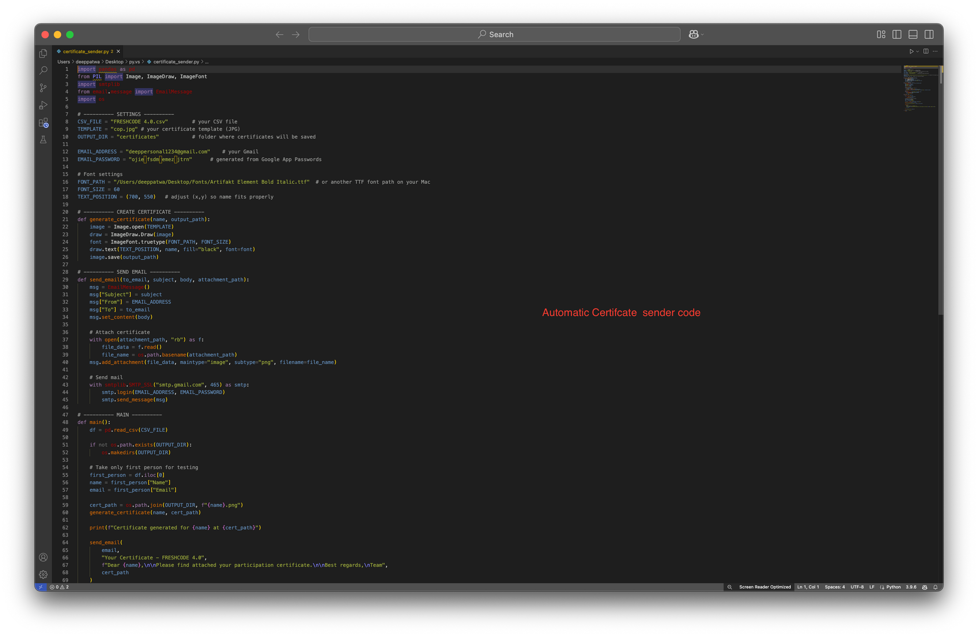
program committee

Slide 24
program committee
• The Program committee or what we call the concept catalysts is R&D sector of our club!
• What it takes to plan, organise and finally execute an event is what you’d learn here.
• Brainstorming , making notes and a lot of management comes in play over here.
• If you always have your bright bulb glowing on, your innovation and creativity can help you and this club run on passionate fuel
• Then comes a great communication, implementation and pitching skills - as we have to coordinate with other committees; so that their is a smooth workflow.
• Let us see few examples of things you might not have used or made -

Slide 25
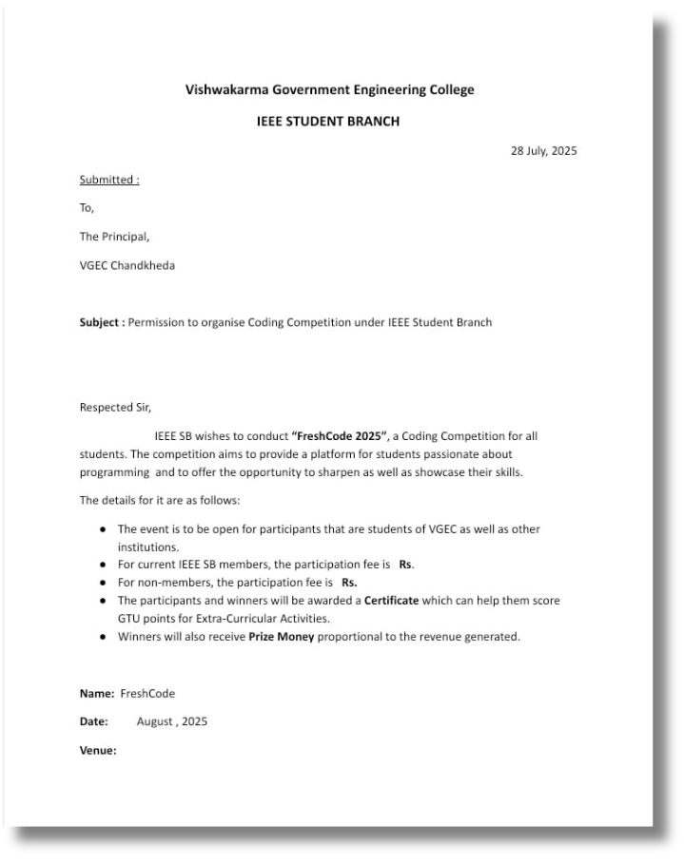
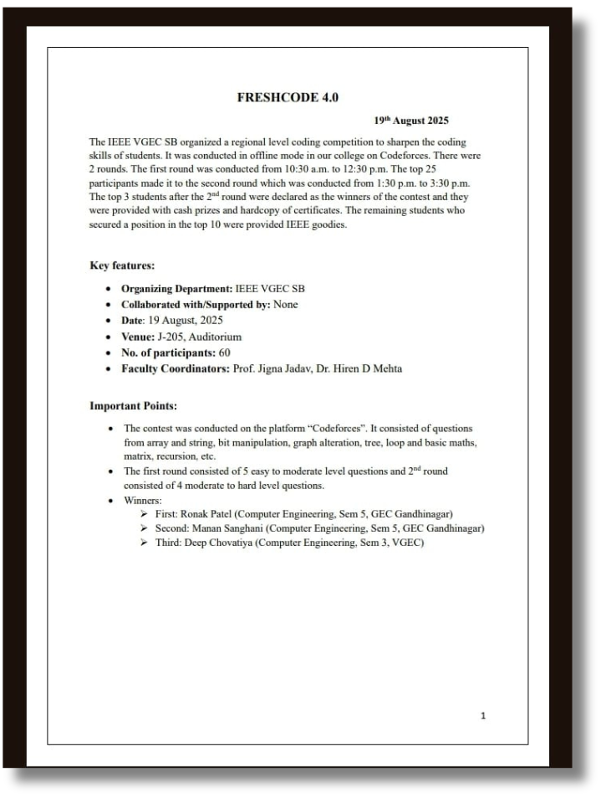
drafting committee
“IF IT’S OFFICIAL, IT’S US.”

Slide 26
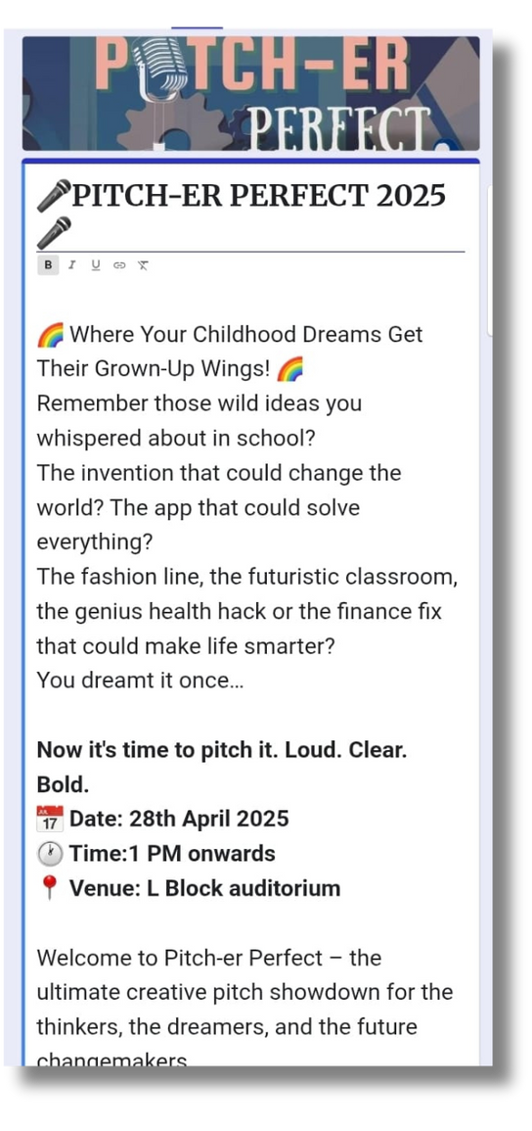
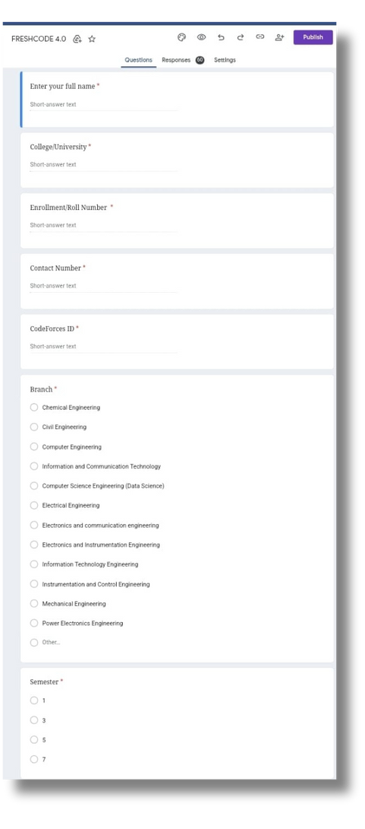
drafting committee
“WE
SHAPE IDEAS INTO LASTING
DOCUMENTS.”

Slide 27
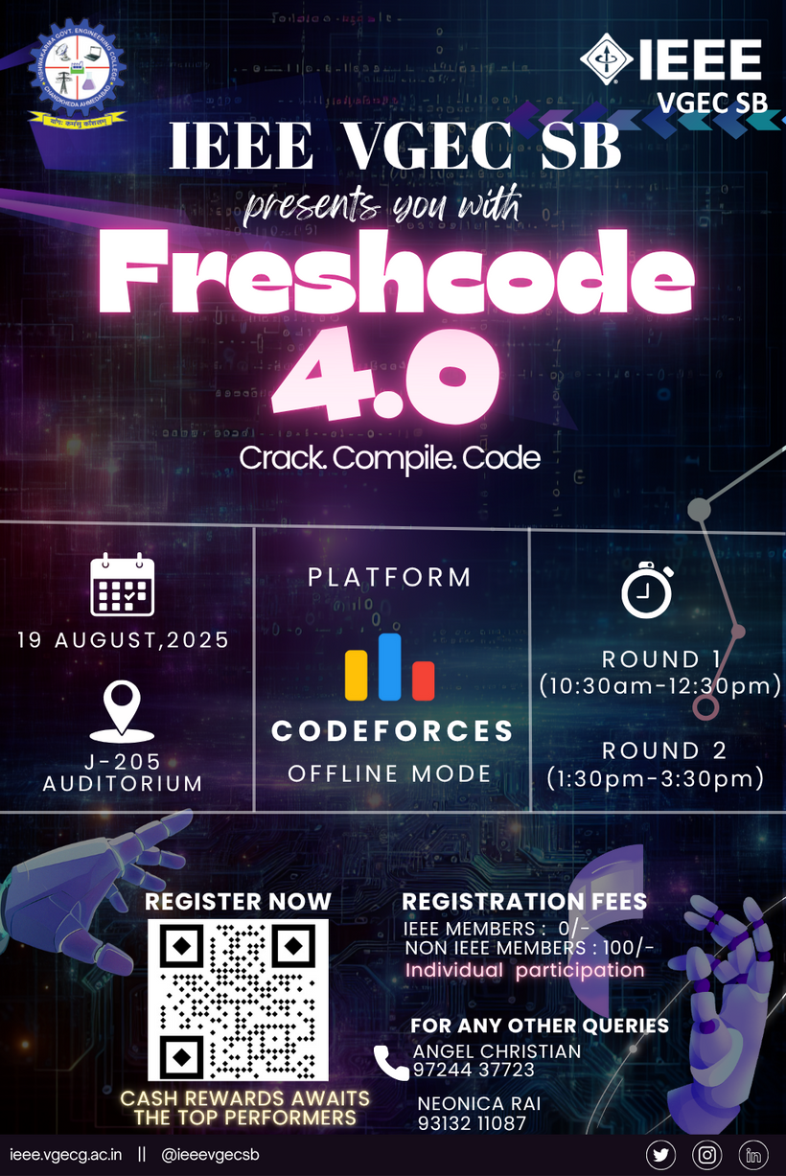

design committee
“WE TURN VISIONS INTO VISUALS.”

Slide 28
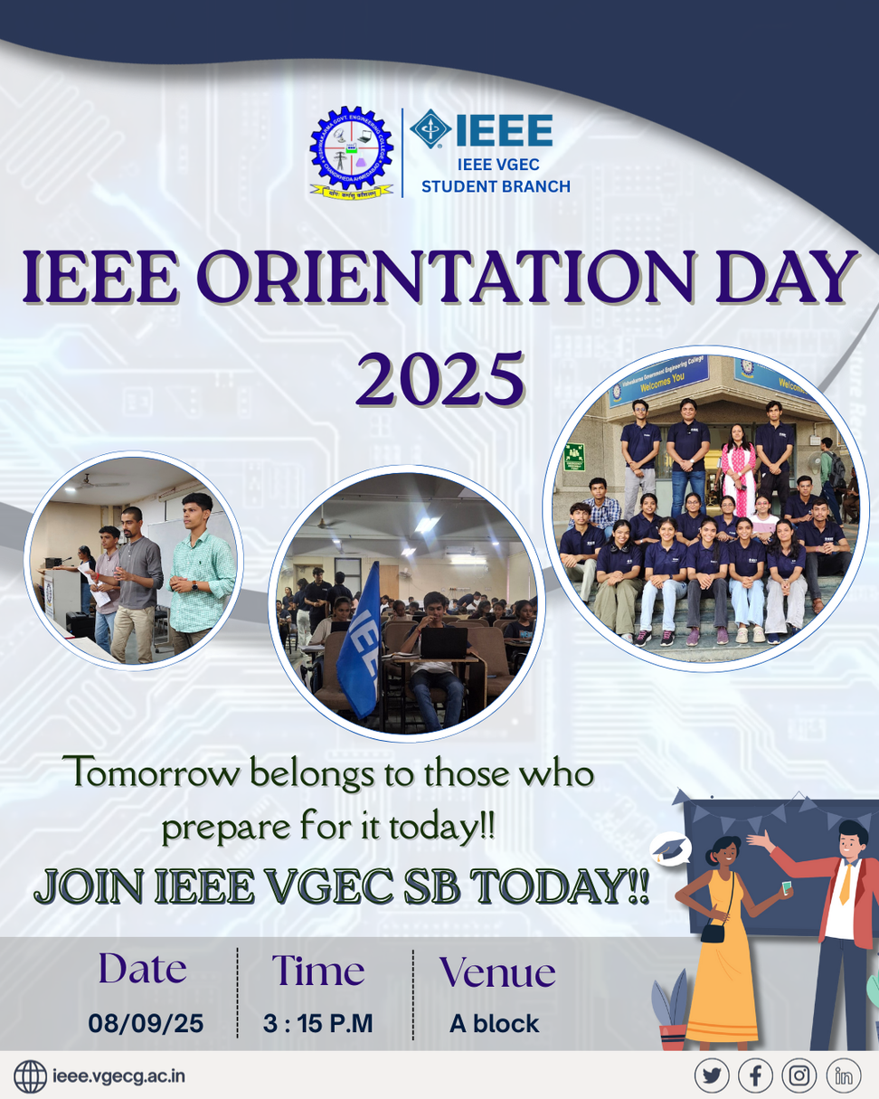

design committee

Slide 29
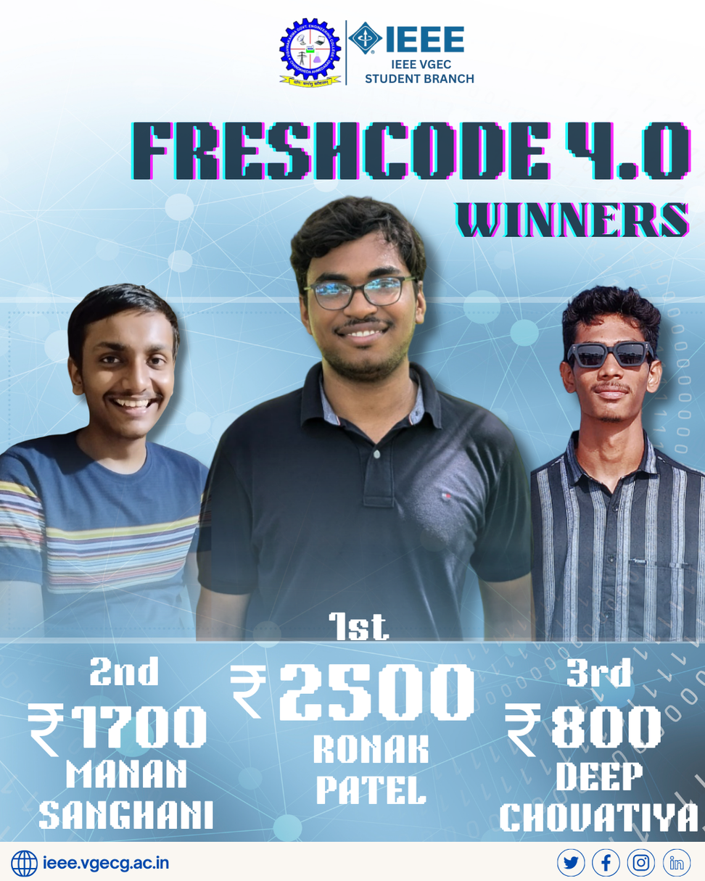
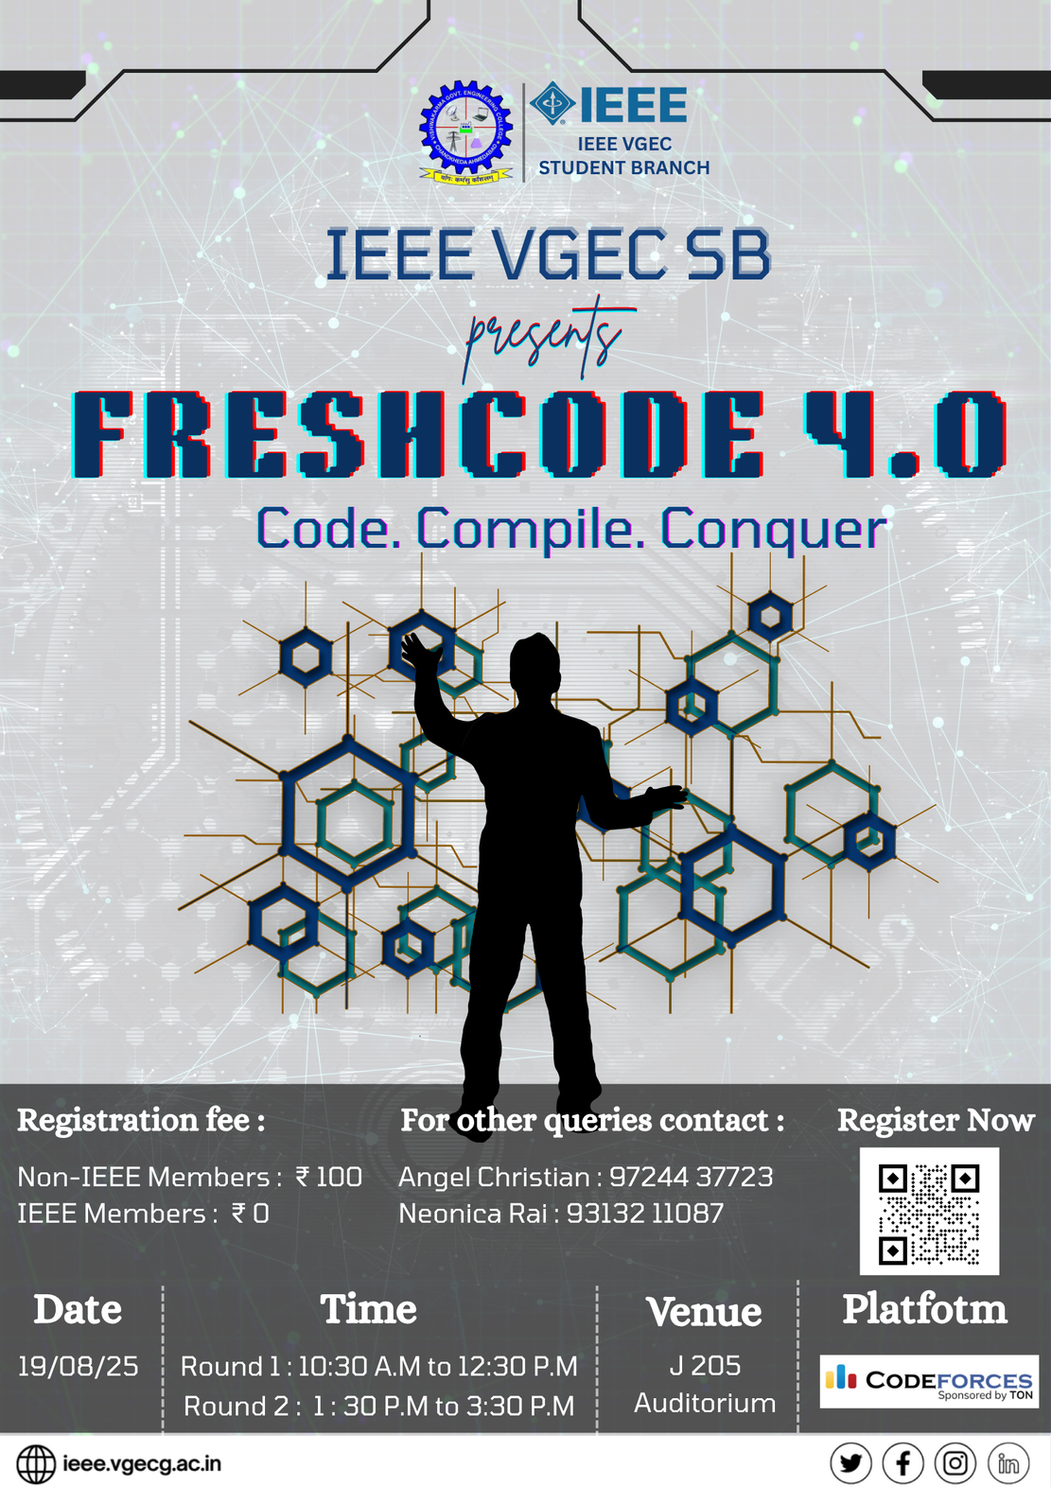
design committee
“IF IT LOOKS GOOD, IT’S US.”

Slide 30
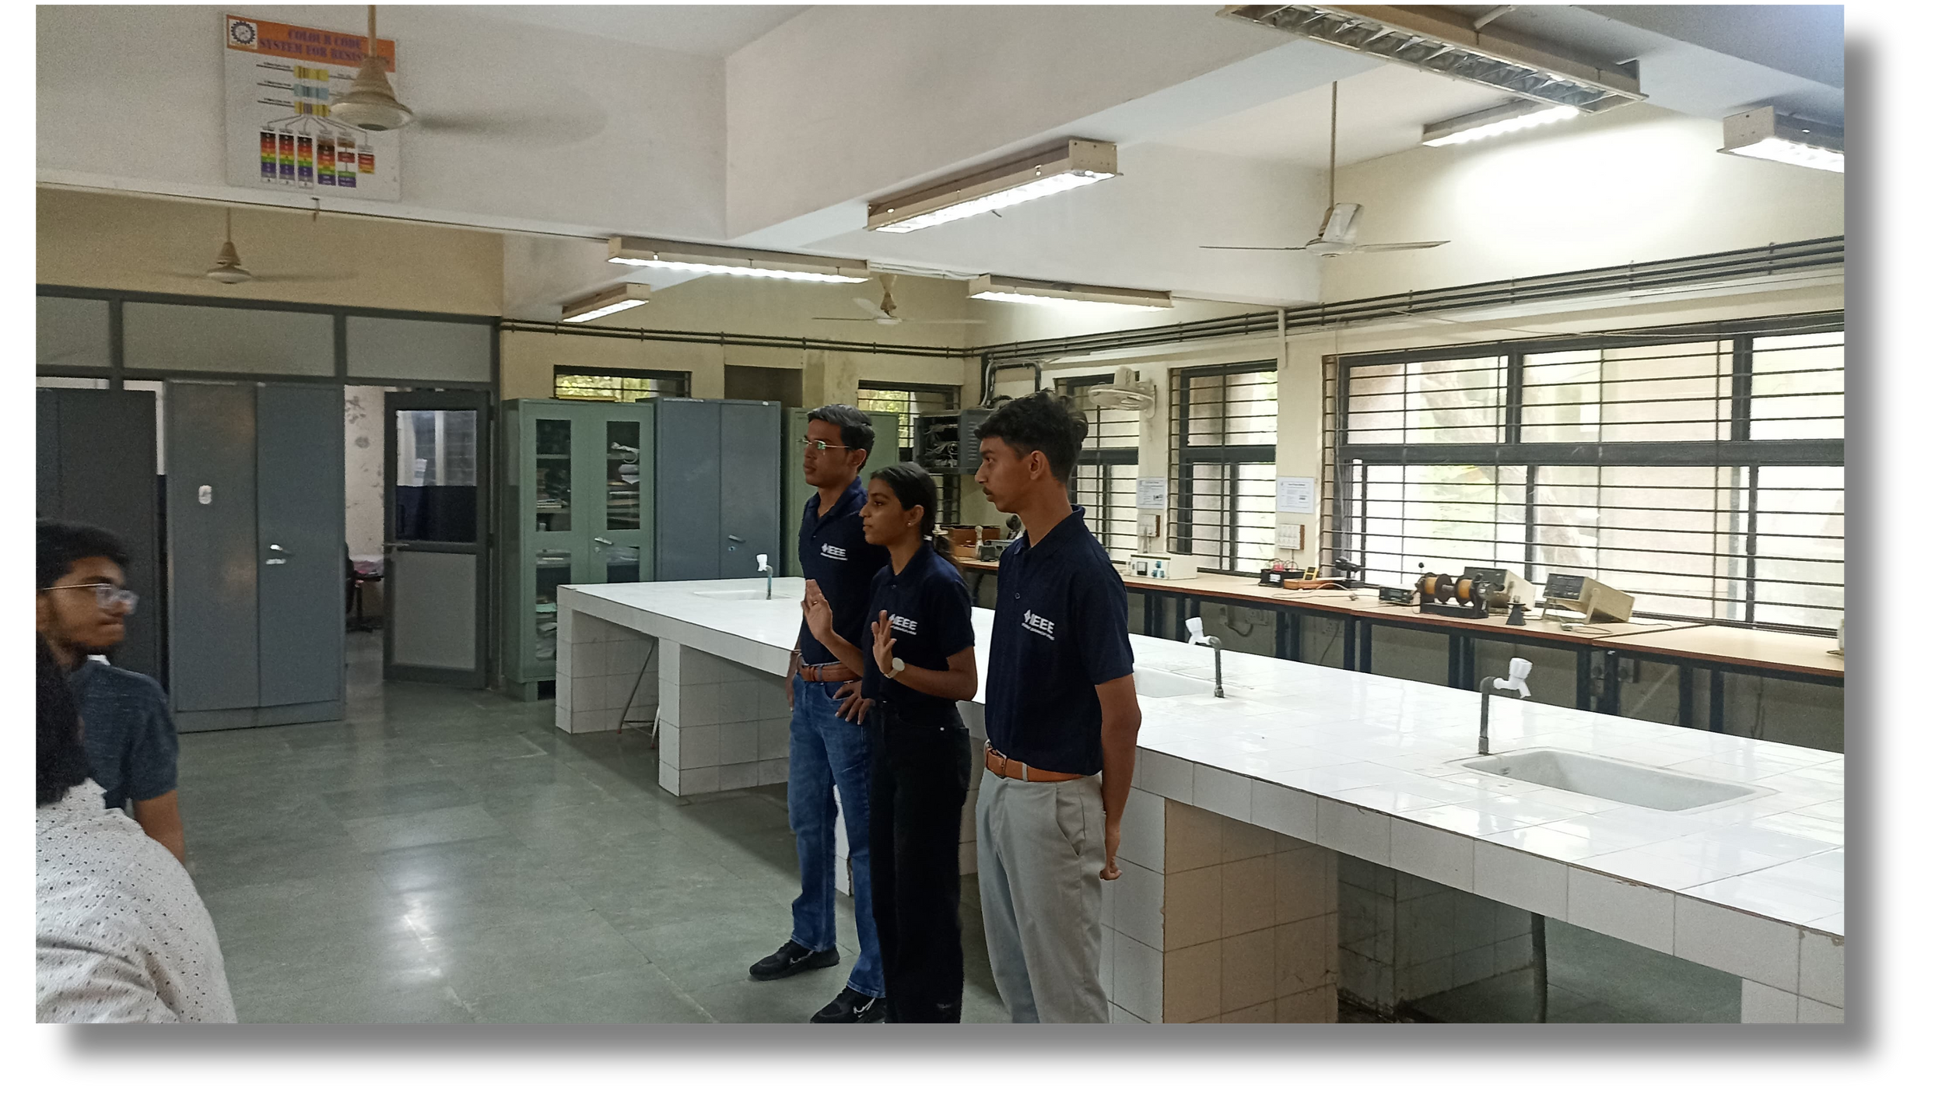
publicity committee
“WE DON’T JUST PROMOTE, WE MAKE IT TREND.”

Slide 31
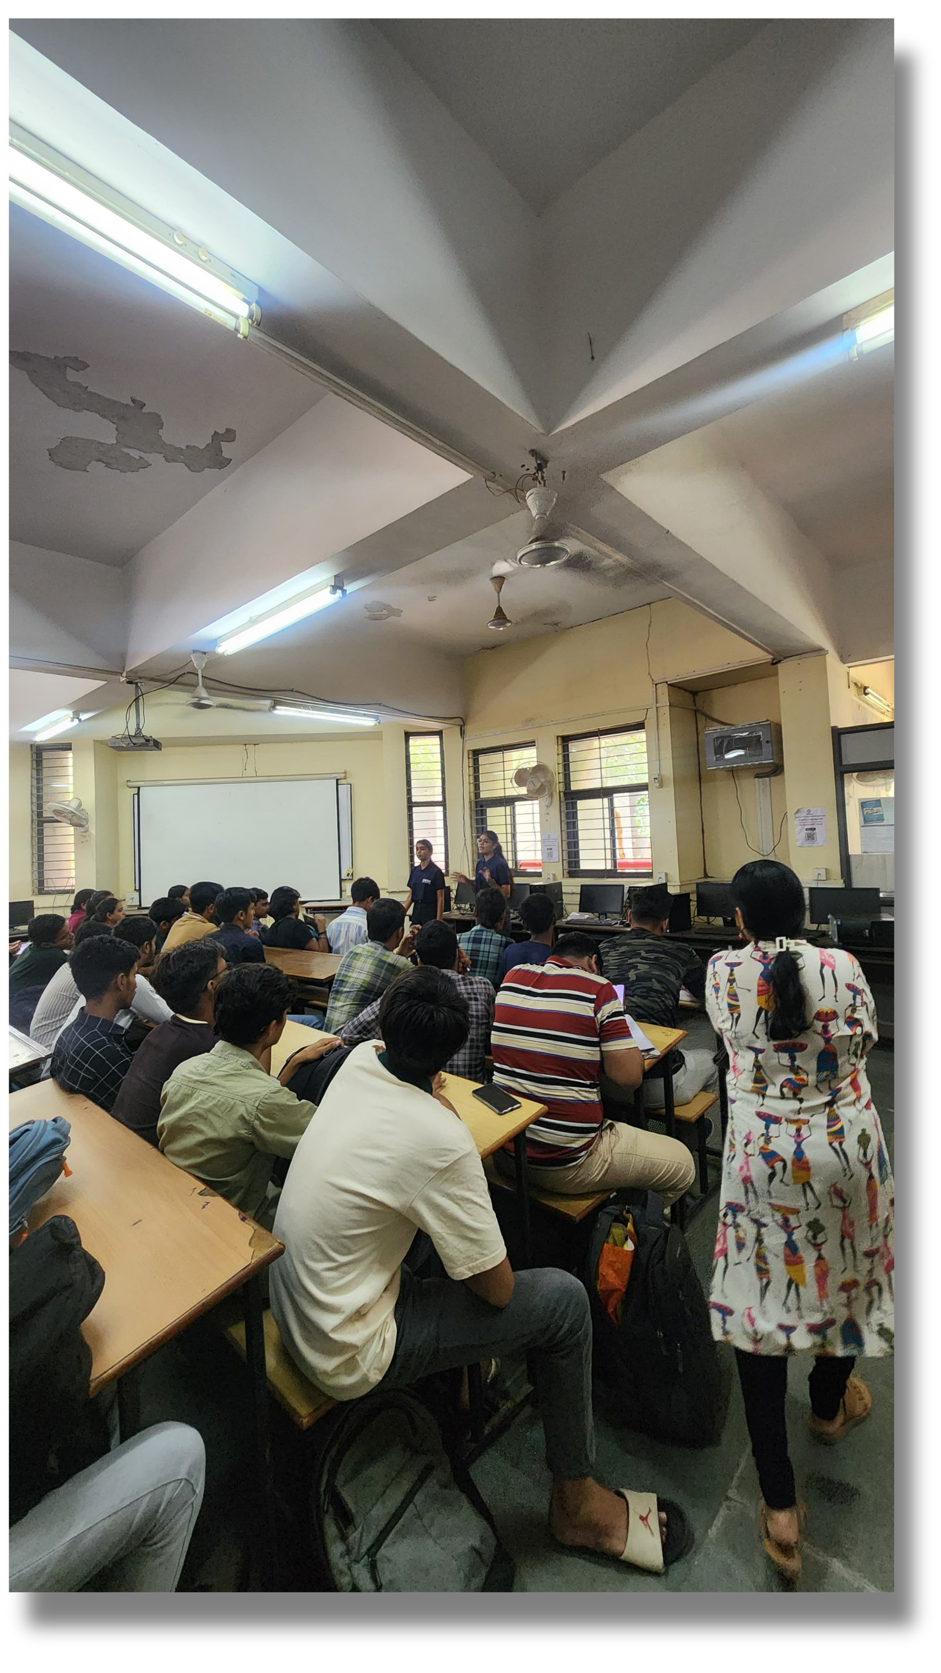
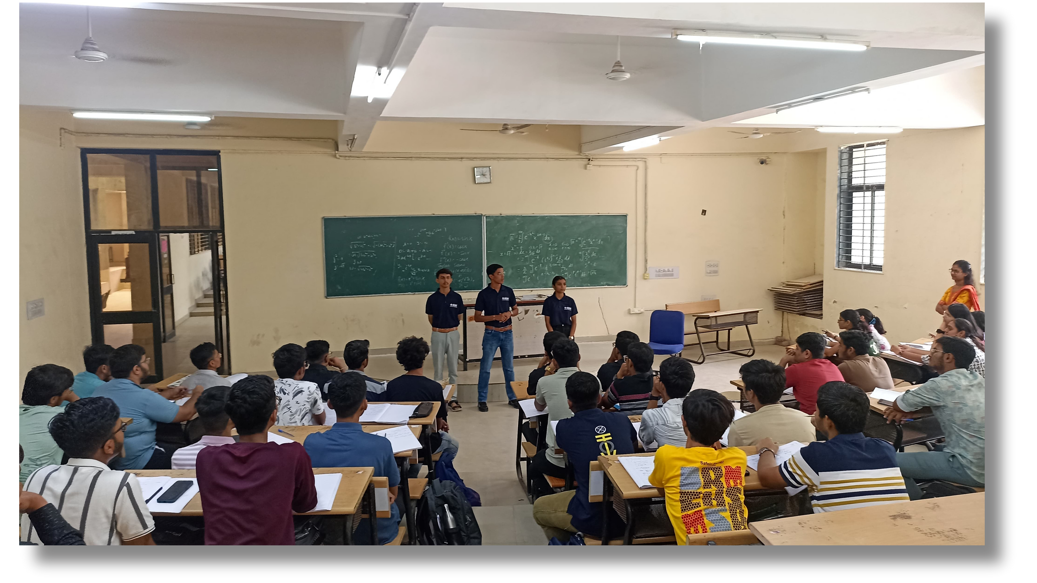
publicity committee

Slide 32
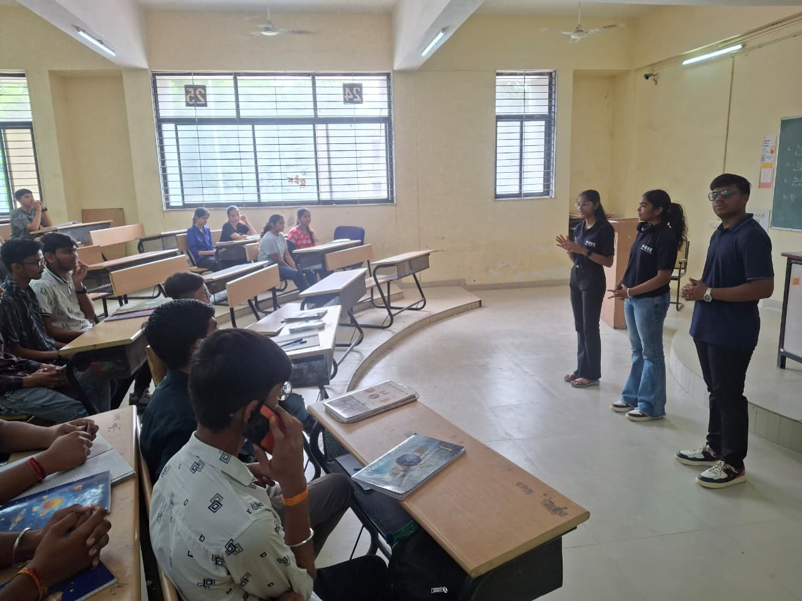
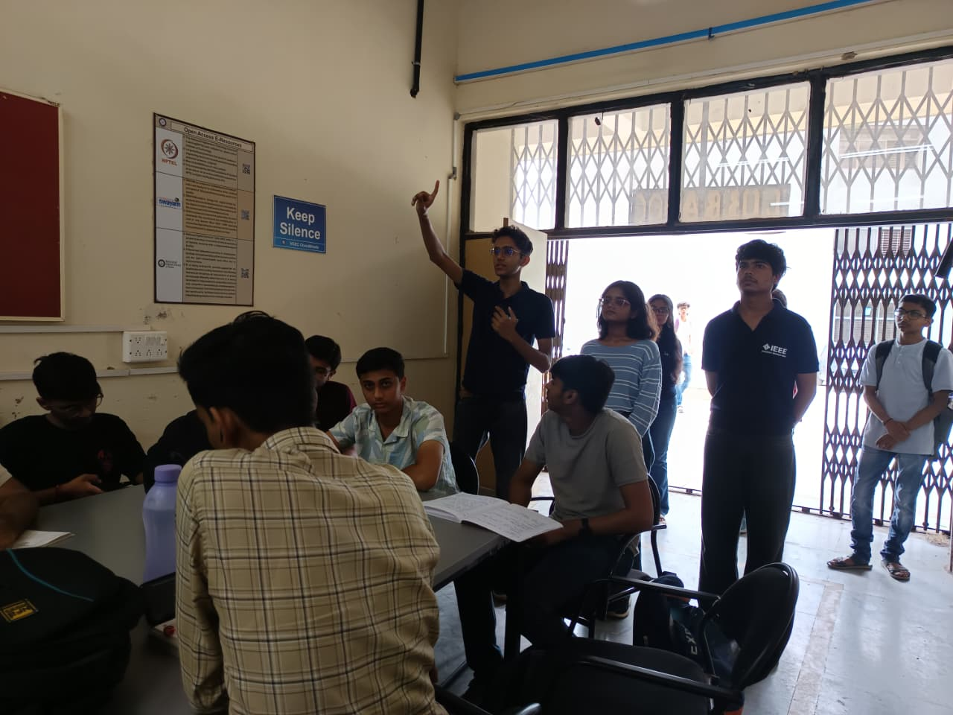
publicity committee

Slide 33
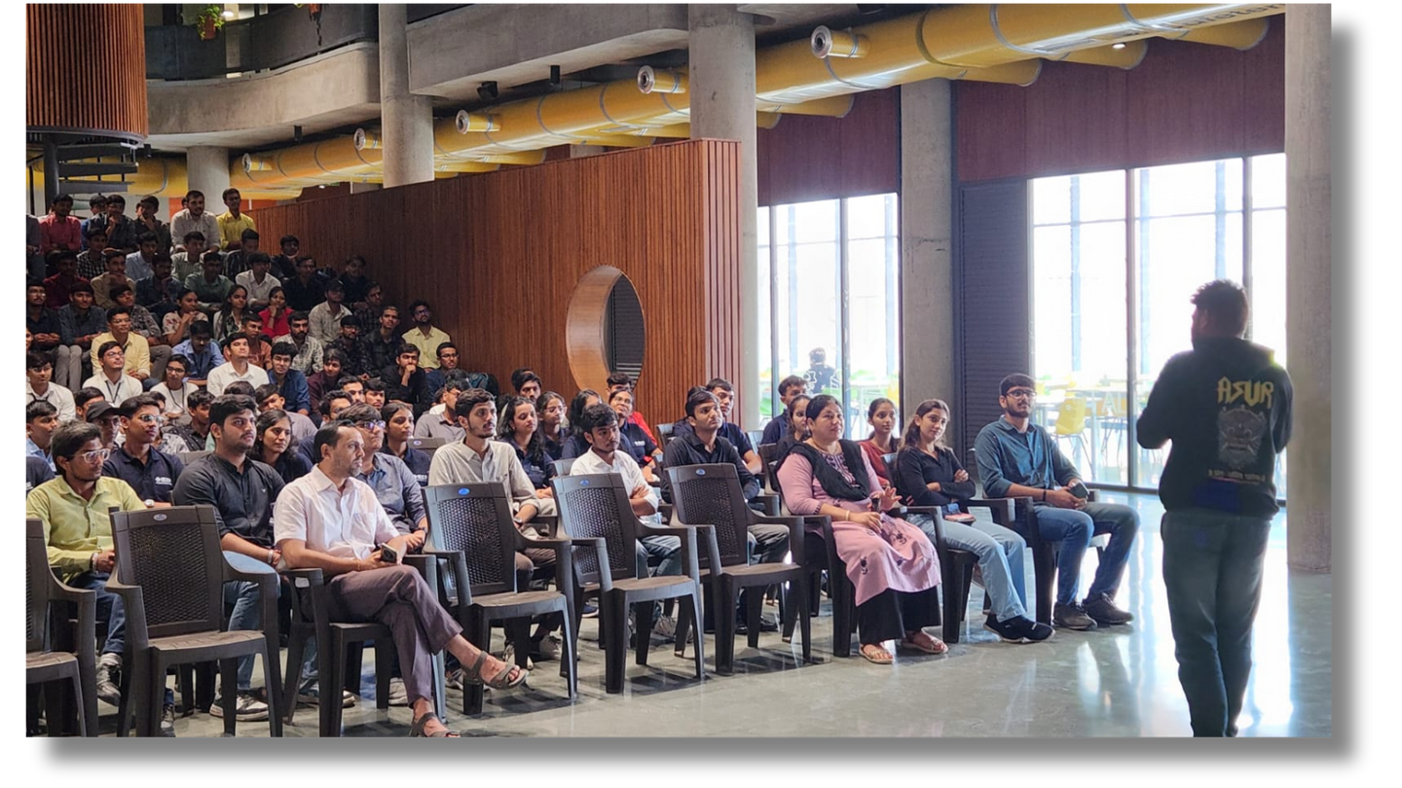
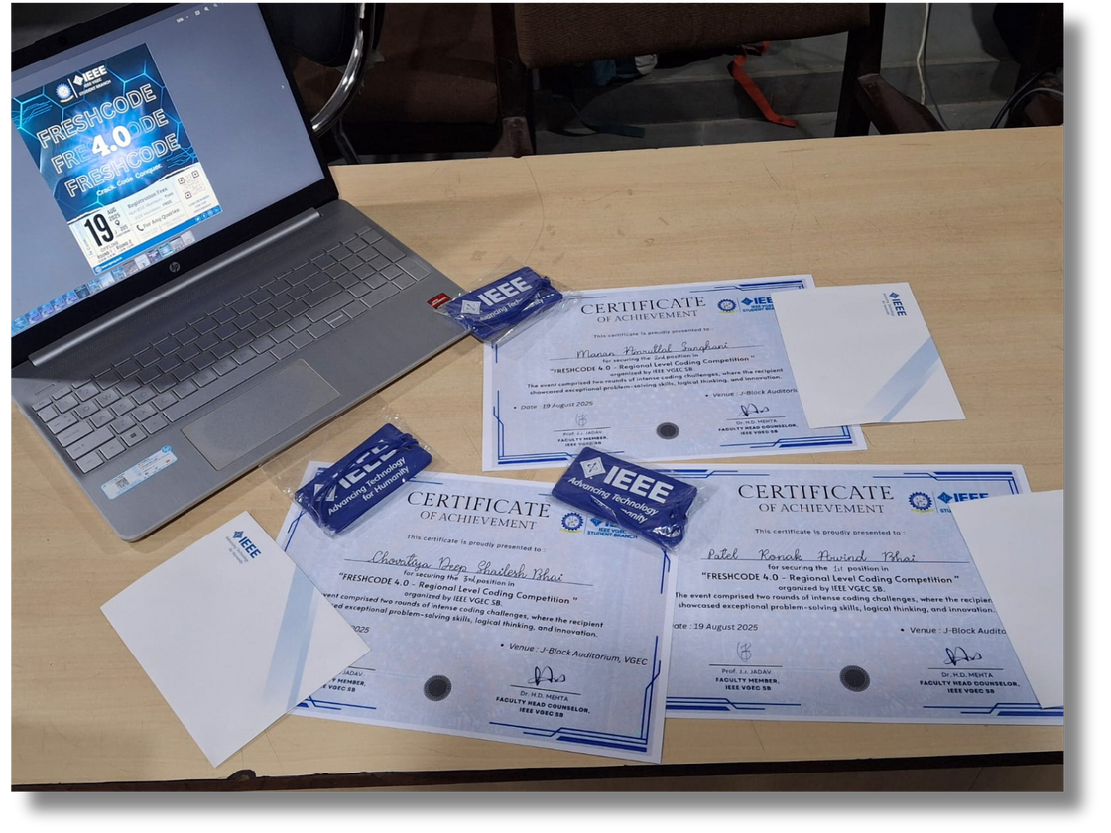
media committee and content committee
“MEDIA SPEAKS LOUDER THAN WORDS.”

Slide 34
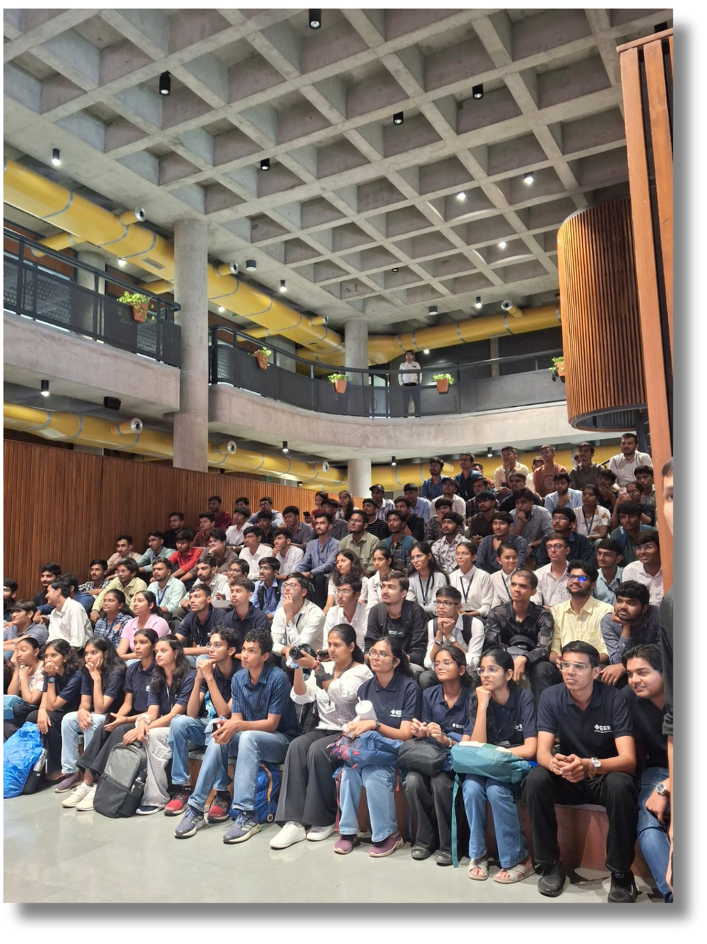
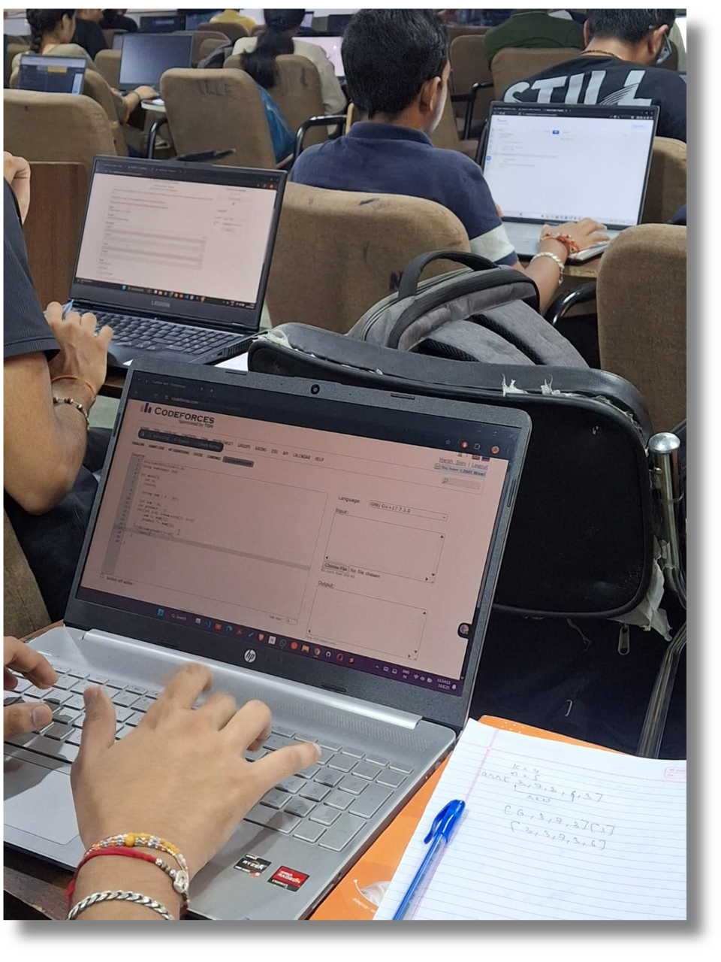
media committee and content committee

Slide 35
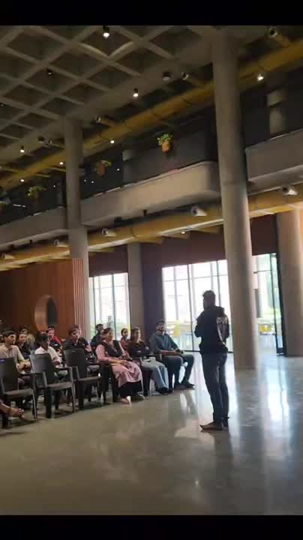

media committee and content committee
“WE CREATE THE CONTENT YOU REMEMBER
”

Slide 36
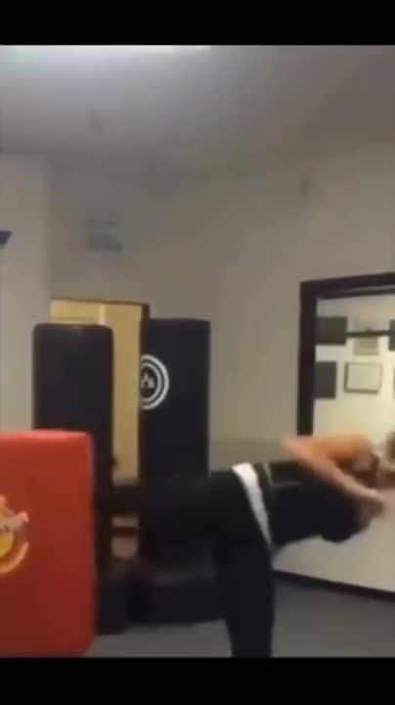
media committee and content committee

Slide 37
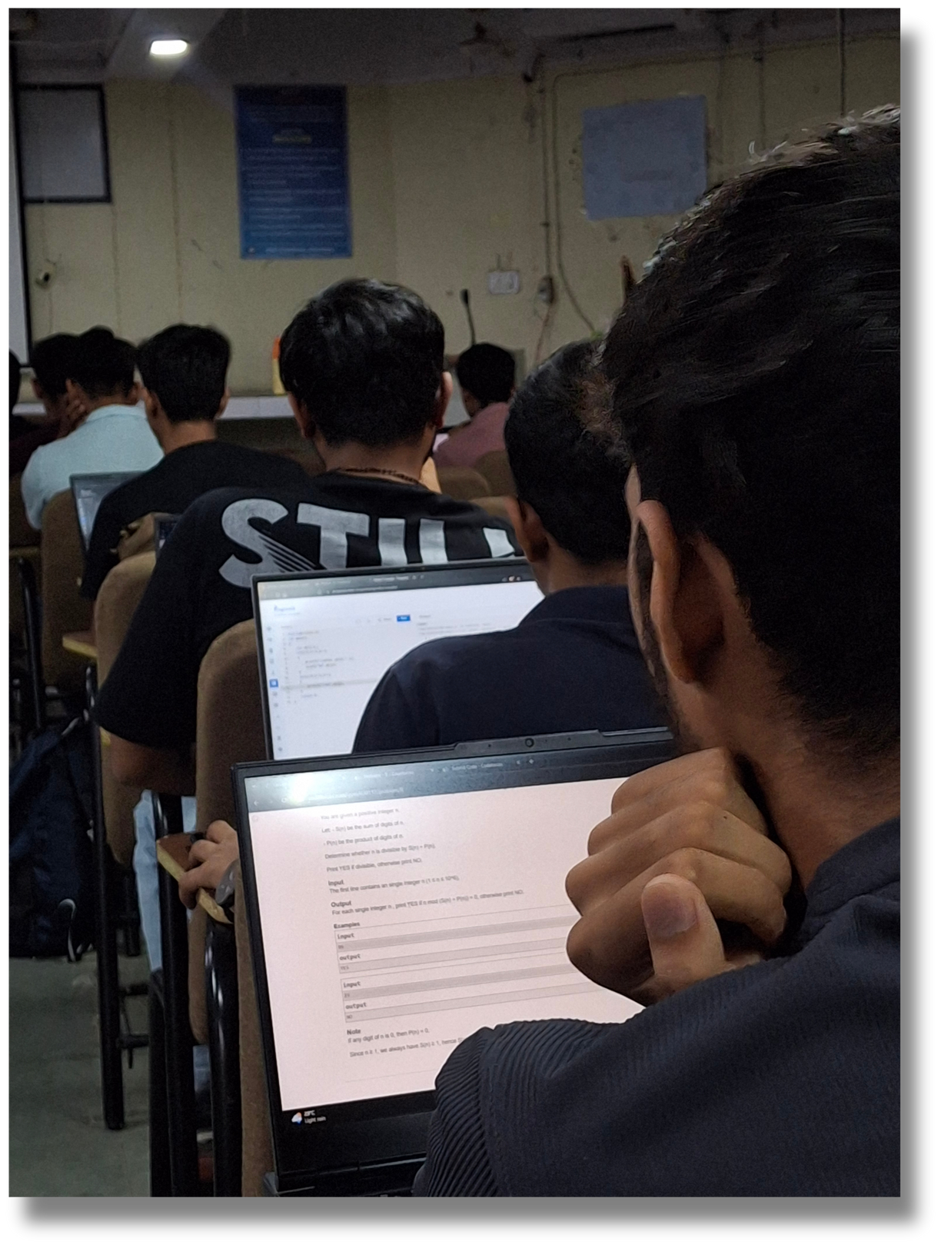

tech committee
“IF IT’S TECHNICAL, IT’S US”

Slide 38
tech committee
What actually tech committee does :
Organize tech events, workshops & coding competitions
Set up projectors, AV equipment & event infrastructure
Web promotion for IEEE events
Build student websites with extra features
Collaborate on Git/GitHub for tech work
Gain hands-on technical experience

Slide 39



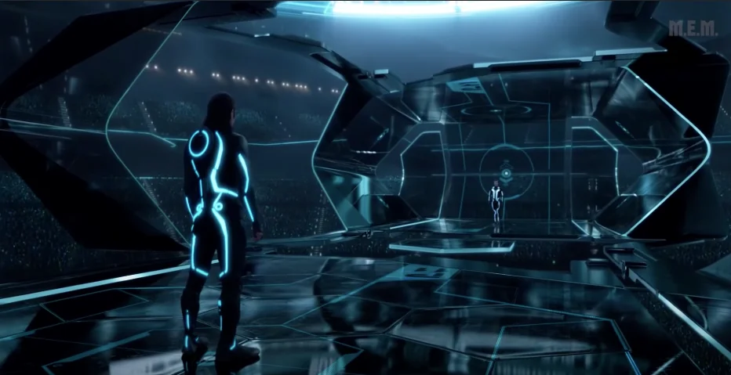
JOINING IN 1ST YEAR
JOINING IN 3RD YEAR
JOINING IN 2NDYEAR
Maximum Advantage!
Gaining momentum!
Fresh Start!
WHEN SHOULD YOU
JOIN IEEE?
Joining in the first year gives you the maximum advantage: full participation in events, long-term projects, leadership opportunities, mentoring fellow mates, and building strong connections for future research, internships and career growth.
Starting in your second year allows you to engage in more projects, take part in competitions, attend workshops, and expand your technical skill and professional network.
Even in your third year, IEEE offers valuable experiences. You can participate in technical events, collaborate on exciting projects and connect with like-minded peers and professionals.
Timing can change your IEEE experience....

Slide 40
JOINING IN 1ST YEAR
JOINING IN 2NDYEAR
JOINING IN 3RD YEAR
WHEN SHOULD YOU
Maximum Advantage!
Gaining momentum!
Fresh Start!
JOIN IEEE?
Starting in your second year allows you to engage in more projects, take part in competitions, attend workshops, and expand your technical skill and professional network.
Even in your third year, IEEE offers valuable experiences. You can participate in technical events, collaborate on exciting projects and connect with like-minded peers and professionals.
Joining in the first year gives you the maximum advantage: full participation in events, long-term projects, leadership opportunities, mentoring fellow mates, and building strong connections for future research, internships and career growth.
Timing can change your IEEE experience....

Slide 41
JOINING IN 1ST YEAR
JOINING IN 3RD YEAR
JOINING IN 2ND YEAR
WHEN SHOULD YOU
Maximum Advantage!
Gaining Momentum!
Fresh Start!
JOIN IEEE?
Joining in the first year gives you the maximum advantage: full participation in events, long-term projects, leadership opportunities, mentoring fellow mates, and building strong connections for future research, internships and career growth.
Even in your third year, IEEE offers valuable experiences. You can participate in technical events, collaborate on exciting projects and connect with like-minded peers and professionals.
Starting in your second year allows you to engage in more projects, take part in competitions, attend workshops, and expand your technical skill and professional network.
Timing can change your IEEE experience....

Slide 42
JOINING IN 1ST YEAR
JOINING IN 3RD YEAR
JOINING IN 2NDYEAR
WHEN SHOULD YOU
Maximum Advantage!
Gaining momentum!
Fresh Start!
JOIN IEEE?
Joining in the first year gives you the maximum advantage: full participation in events, long-term projects, leadership opportunities, mentoring fellow mates, and building strong connections for future research, internships and career growth.
Starting in your second year allows you to engage in more projects, take part in competitions, attend workshops, and expand your technical skill and professional network.
Even in your third year, IEEE offers valuable experiences. You can participate in technical events, collaborate on exciting projects and connect with like-minded peers and professionals.
Timing can change your IEEE experience....

Slide 43
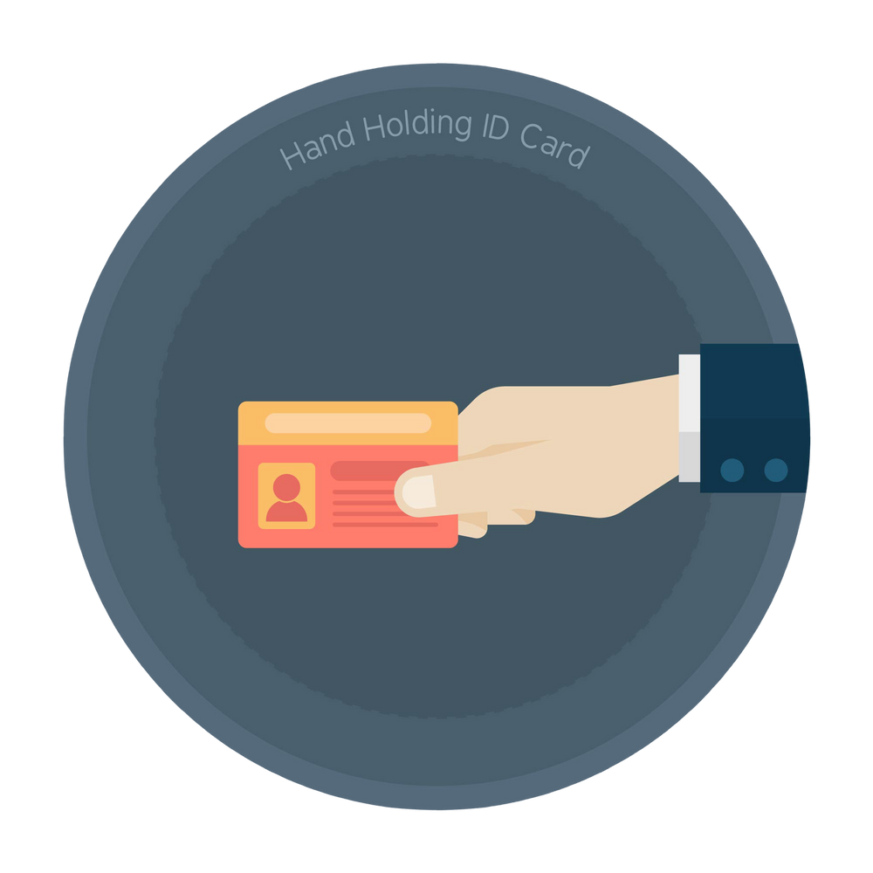
membership committee
We are responsible for recruiting
activities
Recruit and welcome new members
Help students explore opportunities within the club
Build a sense of belonging and teamwork
Maintain connections with current members
Organize membership drives and outreach activities
“WE BUILD THE FAMILY BEHIND THE CLUB.”

Slide 44
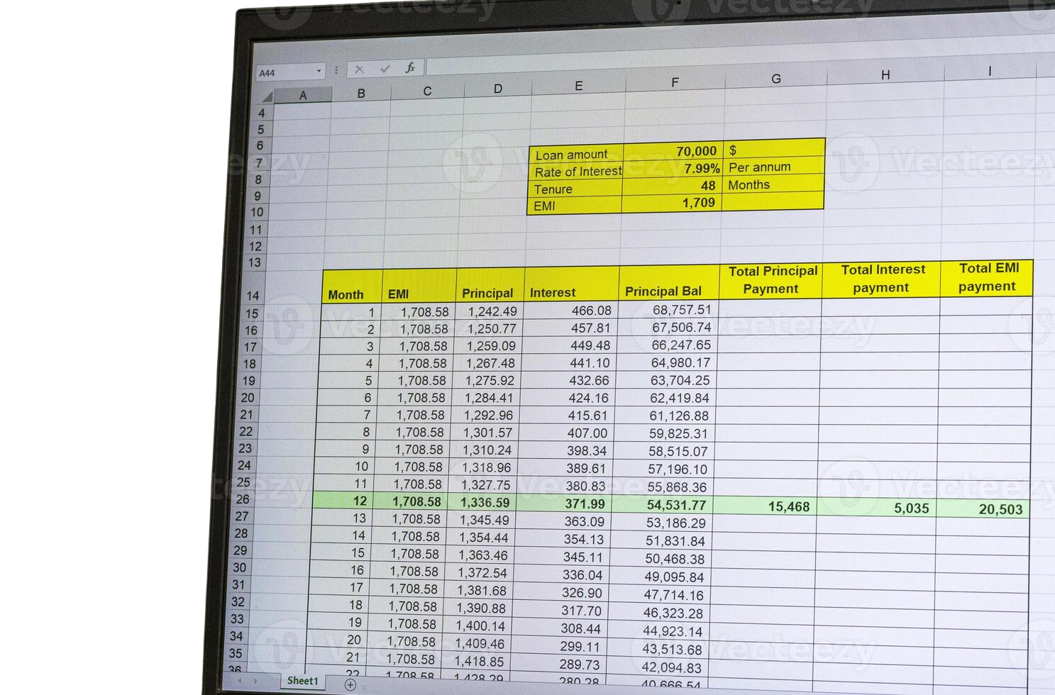

finance committee
“FUNDS IN SAFE HANDS, EVENTS IN FULL SWING.”
“WITHOUT US, PLANS REMAIN JUST PLANS.”

Slide 45

nominating committee
Maintain Updated Member Records – Ensure accurate data of all active IEEE student members.
Monitor Membership Status – Track renewal dates and remind members to renew on time.
Support Elections & Eligibility – Verify candidates’ membership validity before branch elections.
Strengthen Branch Growth – Promote timely renewals to sustain and expand student branch activities.
“WE SPOT THE SPARK BEFORE IT
SHINES.”

Slide 46


Slide 47



Slide 49
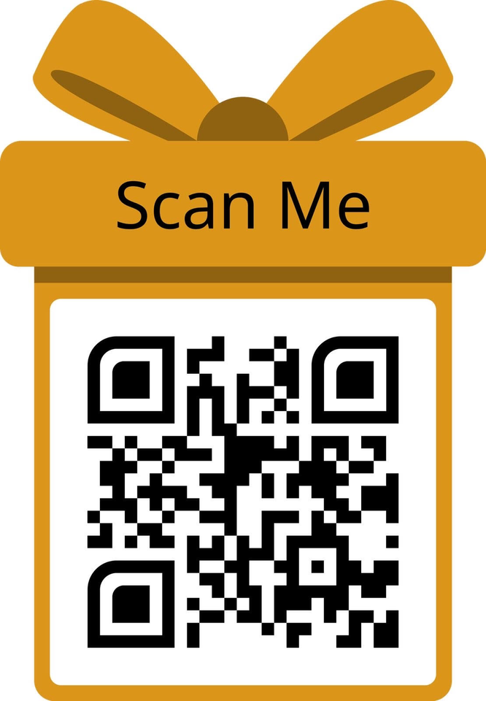
Link: https://forms.gle/ijnN7HTXJLDQRC6JA

Slide 50




Let’s talk
Your Questions,
Our Answers
Please raise your hand for questions.
We value your feedback.

Slide 51

THANK
YOU

